Slide 1

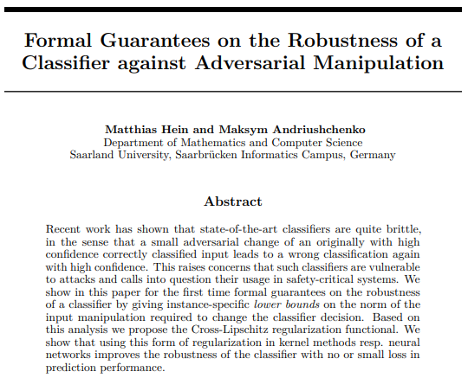
First
Formal Guarantees on the Robustness of a Classifier against Adversarial Manipulation
(Local Lipschitz Constant )
Matthias Hein, Maksym Andriushchenko
Saarland University,
NIPS 2017

Slide 2
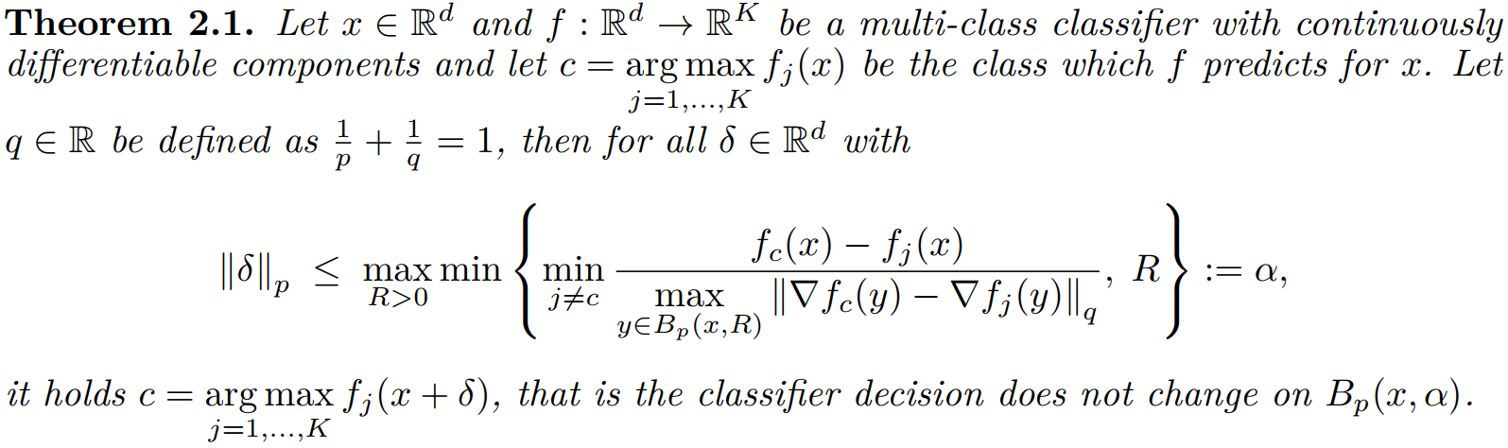

Lipschitz Constant
Brief
Innovation
Propose the formal guarantees on the robustness of a classifier for the first time by giving instance-specific lower bounds on the norm of the input manipulation required to change the classifier decision (that is the radius of the norm ball in which the adversarial perturbation will not change the prediction).
Propose the Cross-Lipschitz regularization functional.
How one can achieve a robustness guarantee ?
$B_{p}\left(x,R\right)=\{y∈ℝ^{d}|{\left|\left|x−y\right|\right|}_{p}≤R\}$
Hein, Matthias, Maksym Andriushchenko. Formal guarantees on the robustness of a classifier against adversarial manipulation. NIPS 2017.
Notes:
$Sup$ 上确界，即最小上届
分段连续可微函数$f(x)$的 𝑝 范数的 Lipschitz 常数 𝐿

Slide 3

Background
Lipschitz Constant
Why introduce Lipschitz Constant to DNN training?
Issue:
Adversarial examples show that there exist small additive perturbations of the input that produce large perturbations at the output of the last layer.
Purpose:
Use Lipschitz Constant to measure and control the additive stability of the network by measuring the spectrum of each rectified layer.
What is Lipschitz Constant?
Lipschitz Continuity: a strong form of uniform continuity for functions.
Lipschitz 连续函数的变化速度是有限的：存在一个实数，使得对于该函数输入域上的每一对点，连接它们的直线斜率的绝对值不大于这个实数。
Lipschitz Constant ($L$): the smallest such bound ($sup\frac{\left|\left|f\left(x\right)−f\left(y\right)\right|\right|}{\left|\left|x−y\right|\right|}=sup L)$.
如果$L=1$，则该函数称为short map；如果 $0≤L<1$，则该函数称为收缩。
 | $$\left||f\left(x\right)−f\left(y\right)|\right|≤L\left||x−y|\right|$$
Szegedy Christian, …, Ian Goodfellow. Intriguing properties of neural networks. arXiv:1312.6199. 2013.

Slide 4


Background
Lipschitz Constant
What is the relationship between the Lipschitz Constant of the output function of the DNN and the adversarial robustness of the DNN?
The output function of the DNN:
The output function of the $k$th layer of the DNN:
The unstability of $φ(x)$can be explained by inspecting the upper Lipschitz constant ($L_{k}$) of each layer$φ_{k}\left(x\right)$ ($k=1,2,…,K$).
The upper Lipschitz constant ($L$) of $φ(x)$:
 | $$φ\left(x\right)=φ_{K}(φ_{K−1}(…φ_{1}(x)))$$
 | $$φ_{k}\left(x\right)=φ_{k}(x;W_{k})$$
 | $$\left|\left|φ_{k}\left(x\right)−φ_{k}\left(x+r\right)\right|\right|≤L_{k}\left|\left|x−\left(x+r\right)\right|\right|=L_{k}|\left|r\right||$$
 | $$\left|\left|φ\left(x\right)−φ\left(x+r\right)\right|\right|≤\prod_{k=1}^{K}{L_{k}}\left|\left|r\right|\right|=L|\left|r\right||$$
Szegedy Christian, …, Ian Goodfellow. Intriguing properties of neural networks. arXiv:1312.6199. 2013.

Slide 5

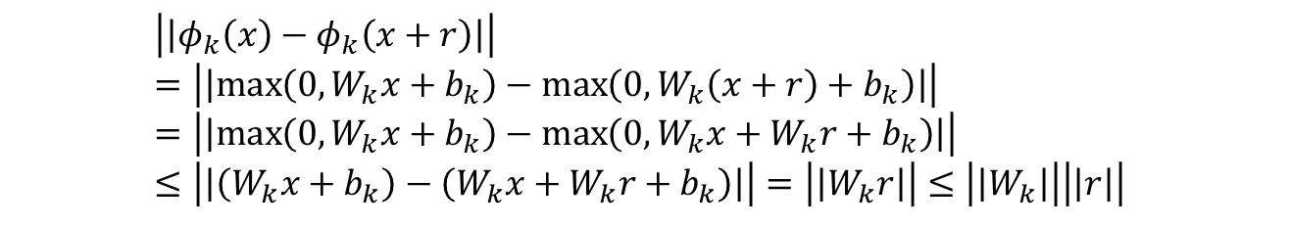
Background
Lipschitz Constant
How to compute the upper Lipschitz constant ($L_{k}$) of a half-rectified layer$φ_{k}\left(x\right)$?
If $φ_{k}\left(x\right)=\max{(0,W_{k}x+b_{k})},$
For all $x,r$,
Thus, upper $L_{k}=\left|\left|W_{k}\right|\right|$.
How to compute the upper Lipschitz constant ($L_{k}$) of a max-pooling layer $φ_{k}\left(x\right)$?
For all $x,r$,
Thus, upper $L_{k}=1$.
 | $$\left|\left|φ_{k}\left(x\right)−φ_{k}\left(x+r\right)\right|\right|=\left|\left|\max\left(0,W_{k}x+b_{k}\right)−\max\left(0,W_{k}\left(x+r\right)+b_{k}\right)\right|\right|=\left|\left|\max\left(0,W_{k}x+b_{k}\right)−\max\left(0,W_{k}x+W_{k}r+b_{k}\right)\right|\right|≤\left|\left|\left(W_{k}x+b_{k}\right)−\left(W_{k}x+W_{k}r+b_{k}\right)\right|\right|=\left|\left|W_{k}r\right|\right|≤\left|\left|W_{k}\right|\right|\left|\left|r\right|\right|$$
 | $$\left|\left|φ_{k}\left(x\right)−φ_{k}\left(x+r\right)\right|\right|≤\left|\left|r\right|\right|$$
Szegedy Christian, …, Ian Goodfellow. Intriguing properties of neural networks. arXiv:1312.6199. 2013.

Slide 6

Background
Lipschitz Constant
How to compute the upper Lipschitz constant ($L_{k}$) of a contrast-normalization layer $φ_{k}\left(x\right)$?
If $φ_{k}\left(x\right)$is a Contrast-normalization function,
For all $x,r$, for $γ∈\left[0.5,1\right],$
Thus, upper $L_{k}=ε^{−γ}$.
Conclusion
Small Lipschitz constant guarantee that no adversarial examples can appear.
Penalizing each upper Lipschitz constant might help improve the generalization error of the networks.
 | $$φ_{k}\left(x\right)=\frac{x}{{\left(ε+x^{2}\right)}^{γ}}$$
 | $$\left|\left|φ_{k}\left(x\right)−φ_{k}\left(x+r\right)\right|\right|≤ε^{−γ}\left|\left|r\right|\right|$$
Szegedy Christian, …, Ian Goodfellow. Intriguing properties of neural networks. arXiv:1312.6199. 2013.

Slide 7
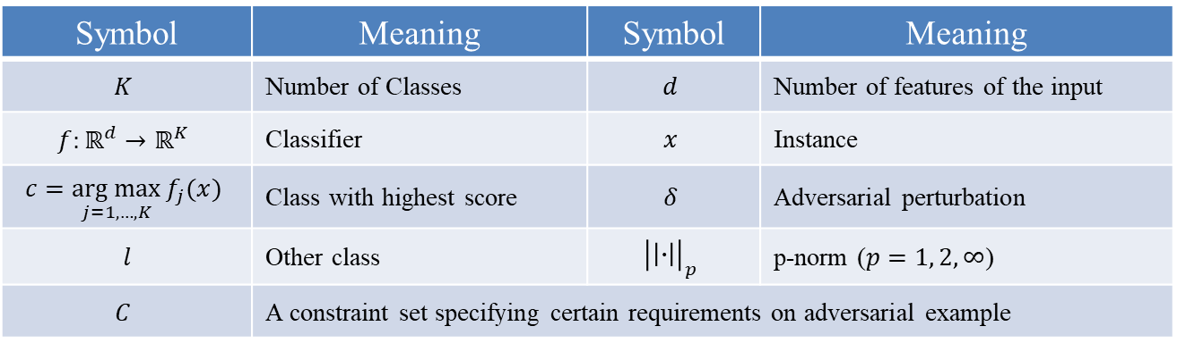

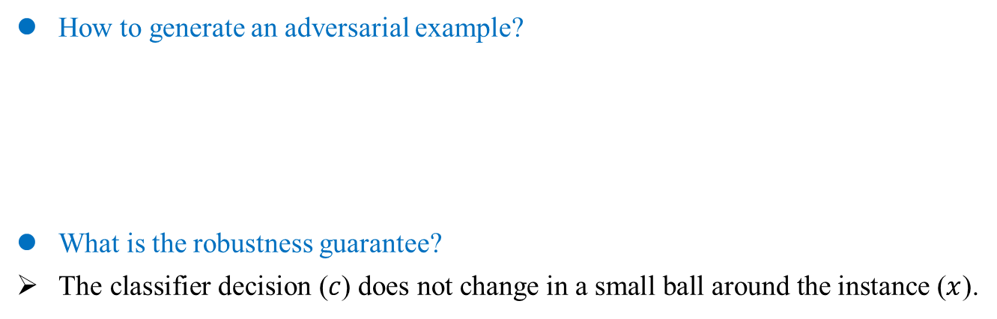
Lipschitz Constant
Notation
Symbol | Meaning | Symbol | Meaning
$$K$$ | Number of Classes | $$d$$ | Number of features of the input
$$f:ℝ^{d}→ℝ^{K}$$ | Classifier | $$x$$ | Instance
$$c=\underset{j=1,…,K}{arg max}{f_{j}(x)}$$ | Class with highest score | $$δ$$ | Adversarial perturbation
$$l$$ | Other class | $${\left|\left|∙\right|\right|}_{p}$$ | p-norm ($p=1, 2, ∞$)
$$C$$ | A constraint set specifying certain requirements on adversarial example
How to generate an adversarial example?
What is the robustness guarantee?
The classifier decision ($c$) does not change in a small ball around the instance ($x$).
 | $$\min_{δ∈ℝ^{d}}{{\left|\left|δ\right|\right|}_{p}},$$ $$s.th. \max_{l ≠c}{f_{l}\left(x+δ\right)≥f_{c}(x+δ)}$$ $$x+δ∈C$$
Hein, Matthias, Maksym Andriushchenko. Formal guarantees on the robustness of a classifier against adversarial manipulation. NIPS 2017.

Slide 8

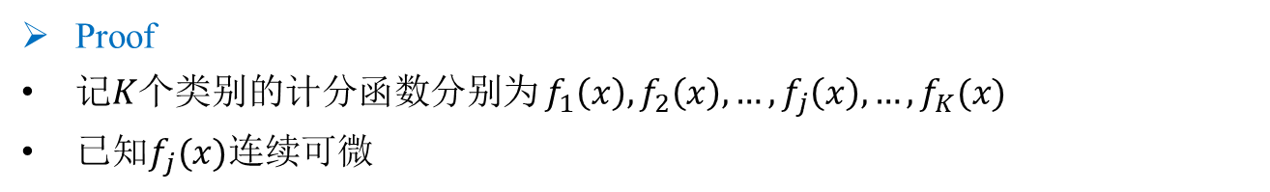
Lipschitz Constant
Theorem
How to achieve a robustness guarantee ?
Definition
Relative difference: $f_{c}\left(x\right)−\max_{j≠c}{f_{j}(x)}$ (冠军类得分$−$亚军类得分)
p-norm ball: $B_{p}\left(x,R\right)=\{y∈ℝ^{d}|{\left|\left|x−y\right|\right|}_{p}≤R\}$
Proof
记$K$个类别的计分函数分别为 $f_{1}\left(x\right),f_{2}\left(x\right),…,f_{j}\left(x\right),…,f_{K}(x)$
已知$f_{j}(x)连续可微$
Hein, Matthias, Maksym Andriushchenko. Formal guarantees on the robustness of a classifier against adversarial manipulation. NIPS 2017.

Slide 9
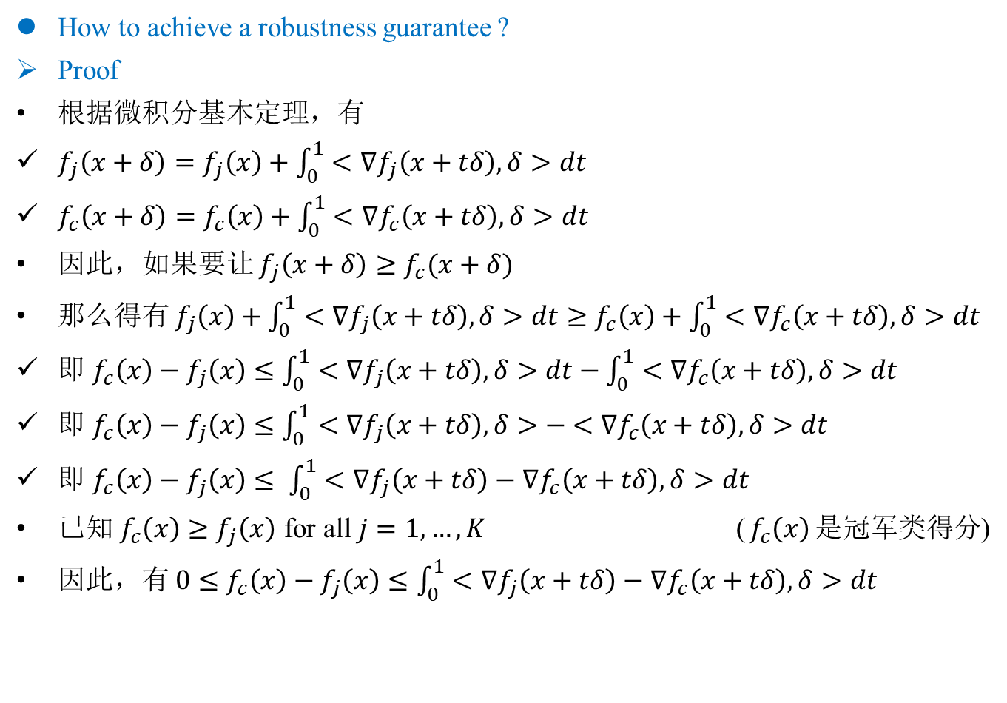
Lipschitz Constant
Theorem
How to achieve a robustness guarantee ?
Proof
根据微积分基本定理，有
$f_{j}\left(x+δ\right)=f_{j}\left(x\right)+\int_{0}^{1}{<∇f_{j}\left(x+tδ\right),δ>dt}$
$f_{c}\left(x+δ\right)=f_{c}\left(x\right)+\int_{0}^{1}{<∇f_{c}\left(x+tδ\right),δ>dt}$
因此，如果要让 $f_{j}\left(x+δ\right)≥f_{c}(x+δ)$
那么得有 $f_{j}\left(x\right)+\int_{0}^{1}{<∇f_{j}\left(x+tδ\right),δ>dt}≥f_{c}\left(x\right)+\int_{0}^{1}{<∇f_{c}\left(x+tδ\right),δ>dt}$
即 $f_{c}\left(x\right)−f_{j}\left(x\right)≤\int_{0}^{1}{<∇f_{j}\left(x+tδ\right),δ>dt}−\int_{0}^{1}{<∇f_{c}\left(x+tδ\right),δ>dt}$
即 $f_{c}\left(x\right)−f_{j}\left(x\right)≤\int_{0}^{1}{<∇f_{j}\left(x+tδ\right),δ>− <∇f_{c}\left(x+tδ\right),δ>dt}$
即 $f_{c}\left(x\right)−f_{j}\left(x\right)≤ \int_{0}^{1}{<∇f_{j}\left(x+tδ\right)−∇f_{c}\left(x+tδ\right),δ>dt}$
已知 $f_{c}\left(x\right)≥f_{j}\left(x\right)$ for all $j=1,…,K$ ($f_{c}\left(x\right)$是冠军类得分)
因此，有 $0≤f_{c}\left(x\right)−f_{j}\left(x\right)≤\int_{0}^{1}{<∇f_{j}\left(x+tδ\right)−∇f_{c}\left(x+tδ\right),δ>dt}$
?
?
Hein, Matthias, Maksym Andriushchenko. Formal guarantees on the robustness of a classifier against adversarial manipulation. NIPS 2017.
Notes:
$<∇f_{j}\left(x+tδ\right),δ>表示$变量\delta的积分平均值

Slide 10

Lipschitz Constant
Theorem
How to achieve a robustness guarantee ?
Proof
因此，有 $0≤f_{c}\left(x\right)−f_{j}\left(x\right)≤\int_{0}^{1}{<∇f_{j}\left(x+tδ\right)−∇f_{c}\left(x+tδ\right),δ>dt}$
根据Holder不等式，$q$-norm是$p$-norm的对偶，即$\frac{1}{p}+\frac{1}{q}=1$,
因此，有 ${\left|\left|δ\right|\right|}_{p}≥\frac{f_{c}\left(x\right)−f_{j}\left(x\right)}{\int_{0}^{1}{{\left|\left|∇f_{j}\left(x+tδ\right)−∇f_{c}(x+tδ)\right|\right|}_{q}dt}}$
移向得， $0≤f_{c}\left(x\right)−f_{j}\left(x\right)≤{\left|\left|δ\right|\right|}_{p}\int_{0}^{1}{{\left|\left|∇f_{j}\left(x+tδ\right)−∇f_{c}(x+tδ)\right|\right|}_{q}dt}$
给定一个半径固定为$R$的$p$-norm球 $B_{p}(x,R)$，
有 $\sup_{δ∈B_{p}(0,R)}\int_{0}^{1}{{\left|\left|∇f_{j}\left(x+tδ\right)−∇f_{c}(x+tδ)\right|\right|}_{q}dt}≤\max_{y∈B_{p}(x,R)}{{\left|\left|∇f_{j}\left(y\right)−∇f_{c}\left(y\right)\right|\right|}_{q}}$
因此， ${\left|\left|δ\right|\right|}_{p}≥\min\left\{R,\frac{f_{c}\left(x\right)−f_{j}\left(x\right)}{\int_{0}^{1}{{\left|\left|∇f_{j}\left(x+tδ\right)−∇f_{c}\left(x+tδ\right)\right|\right|}_{q}dt}}\right\}≔α$
即， ${\left|\left|δ\right|\right|}_{p}<α$ 时，不存在$f_{j}\left(x+δ\right)≥f_{c}(x+δ)。$得证。
?
?
Local Lipschitz Constant
Hein, Matthias, Maksym Andriushchenko. Formal guarantees on the robustness of a classifier against adversarial manipulation. NIPS 2017.

Slide 11
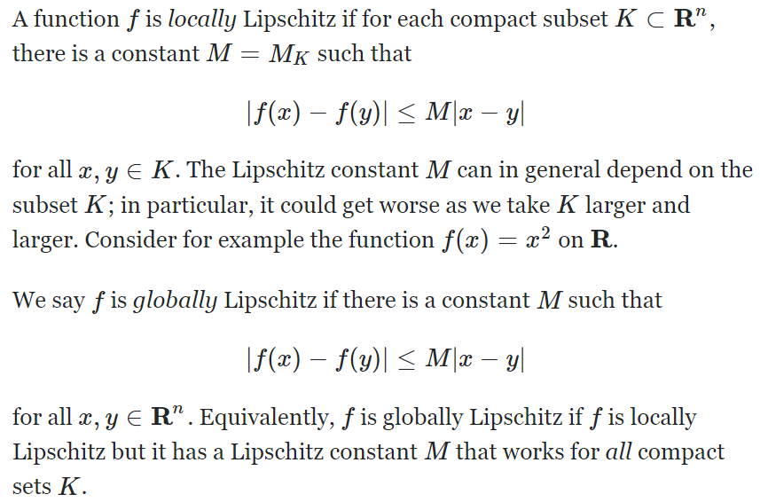
Lipschitz Constant
Local Lipschitz
Local Lipschitz
Global Lipschitz

Slide 12

Lipschitz Constant
Local Lipschitz
Global Lipschitz Constant-based Regularization
Purpose:
Reduce the network’s sensitivity to small perturbations by controlling its global Lipschitz constant.
Method:
A layerwise regularization method, Parseval networks, for maintaining a small Lipschitz constant at every hidden layer (fully-connected, convolutional or residual).
The key quantity governing the local Lipschitz constant is the spectral norm (谱范数，$L_{2} Norm$) of the weight matrix $W$. Main idea is to control this norm by parameterizing the network with parseval tight frames.
Effect:
Achieve increased robustness.
Cisse Moustapha,…, Nicolas Usunier. Parseval networks: Improving robustness to adversarial examples. ICML, 2017.

Slide 13


Lipschitz Constant
Local Lipschitz
Flaw of Global Lipschitz Constant-based Regularization
In [L-BFGS, Parseval], they suggest to study the global Lipschitz constant of each score $f_{j}, j=1, . . . , K$.
A small global Lipschitz constant for all $f_{j}$ implies a good bound as,
But the converse does not hold.
Global Lipschitz constant would be influenced by the sharp transition zones and would not yield a good bound. Local bound can adapt to regions where the classifier is approximately constant and then yields good guarantees.
Local estimates are better than the global estimates which implies better robustness guarantees, that means tight bound.
 | $${\left|\left|∇f_{j}\left(y\right)−∇f_{c}\left(y\right)\right|\right|}_{q}≤{\left|\left|∇f_{j}\left(y\right)\right|\right|}_{q}+{\left|\left|∇f_{c}\left(y\right)\right|\right|}_{q}$$
?
?
 | $${\left|\left|δ\right|\right|}_{p}=\min_{j≠c}{\frac{<w_{c}−w_{j},x>}{{\left|\left|w_{c}−w_{j}\right|\right|}_{q}}}$$
?
Hein, Matthias, Maksym Andriushchenko. Formal guarantees on the robustness of a classifier against adversarial manipulation. NIPS 2017.
Notes:
一个小的全局 Lipschitz 常数对所有 𝑓 意味着一个良好的界限。反之不成立

Slide 14

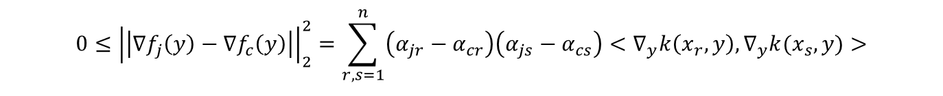
Lipschitz Constant
Kernel Method
Evaluation of the Bound for Kernel Methods
Notation
Training points: $x_{1}, x_{2},…,x_{r},…,x_{n}$
Positive definite kernel function: $k: ℝ^{d}×ℝ^{d}→ℝ$
Trained parameters of a SVM: $α∈ℝ^{K×n}$
The classifier of kernel methods: $f_{j}\left(x\right)=\sum_{r=1}^{n}{α_{jr}k(x_{r},x)}$
The goal is to upper bound the term $\max_{y∈B_{2}(x,R)}{\left|\left|∇f_{j}\left(y\right)−∇f_{c}\left(y\right)\right|\right|}_{2}$:
Kernel methods with a Gaussian kernel are robust to noise:
Gaussian kernel: $k\left(x,y\right)=e^{−γ{\left|\left|x−y\right|\right|}_{2}^{2}}$
?
$$0≤{\left|\left|∇f_{j}\left(y\right)−∇f_{c}\left(y\right)\right|\right|}_{2}^{2}=\sum_{r,s=1}^{n}{\left(α_{jr}−α_{cr}\right)\left(α_{js}−α_{cs}\right)<∇_{y}k\left(x_{r},y\right),∇_{y}k(x_{s},y)>}$$
?
?
$<∇_{y}k\left(x_{r},y\right),∇_{y}k(x_{s},y)>$ = $4γ^{2}∙<y−x_{r},y−x_{s}>∙e^{−γ{\left|\left|x_{r}−y\right|\right|}_{2}^{2}}∙e^{−γ{\left|\left|x_{s}−y\right|\right|}_{2}^{2}}$
Hein, Matthias, Maksym Andriushchenko. Formal guarantees on the robustness of a classifier against adversarial manipulation. NIPS 2017.

Slide 15
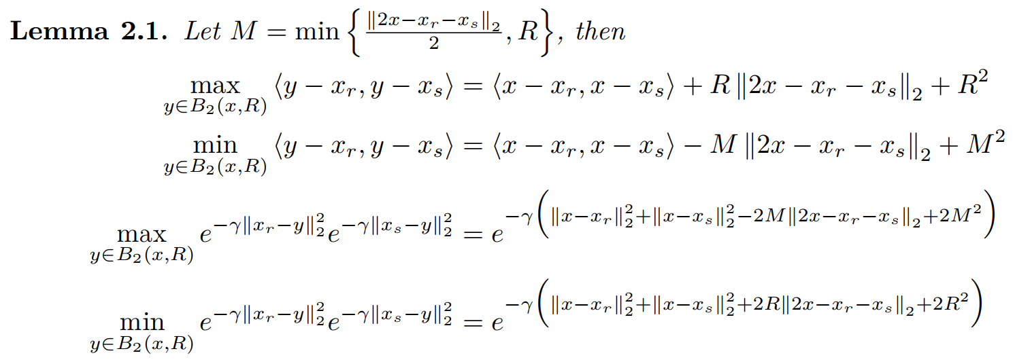
Lipschitz Constant
Kernel Method
Evaluation of the Bound for Kernel Methods
Proof
?
Hein, Matthias, Maksym Andriushchenko. Formal guarantees on the robustness of a classifier against adversarial manipulation. NIPS 2017.

Slide 16
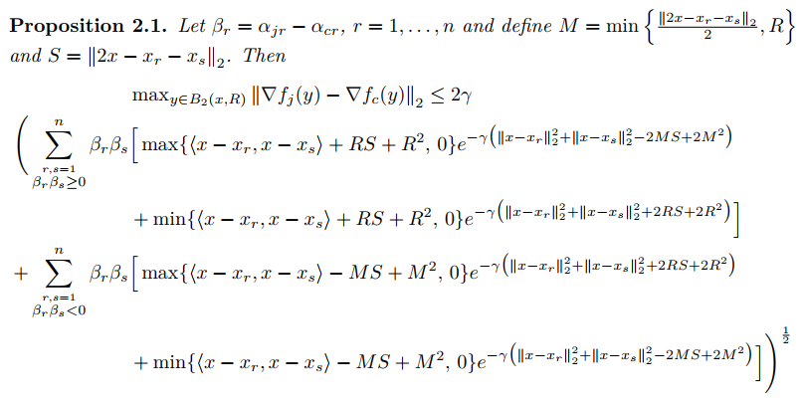
Lipschitz Constant
Kernel Method
Evaluation of the Bound for Kernel Methods
Proof
?
Hein, Matthias, Maksym Andriushchenko. Formal guarantees on the robustness of a classifier against adversarial manipulation. NIPS 2017.

Slide 17
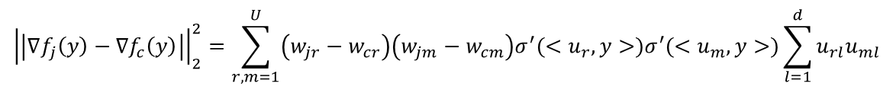


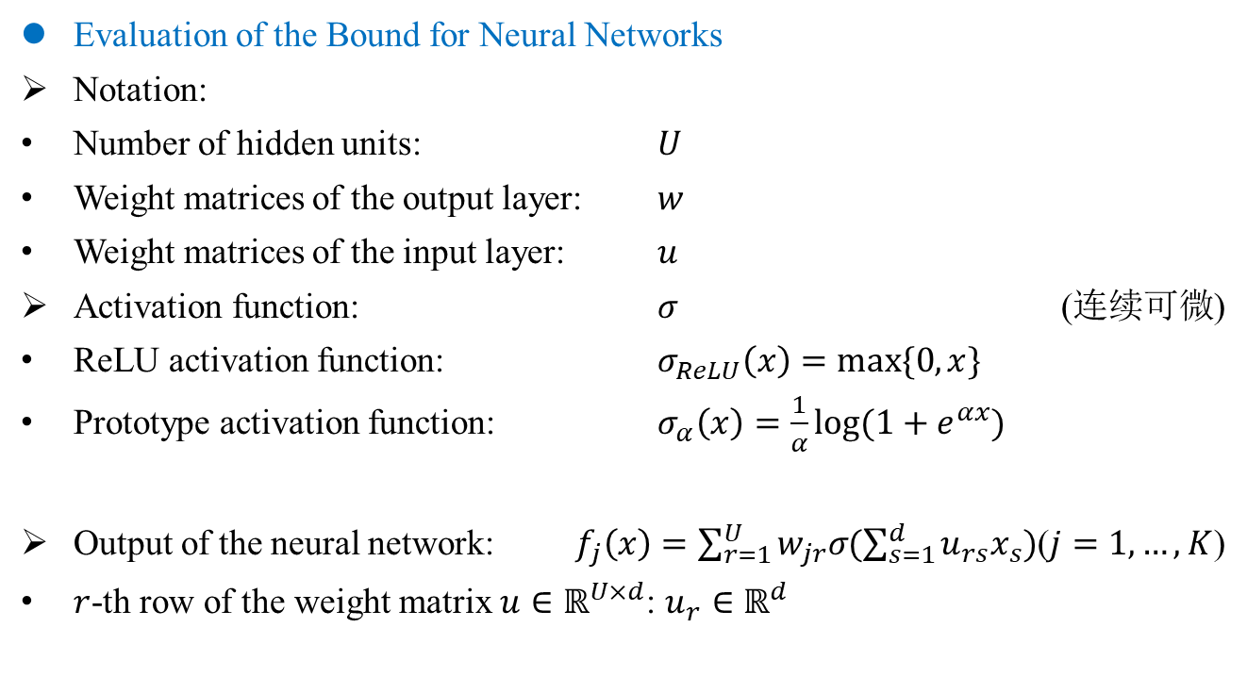
Lipschitz Constant
Neural Network
Evaluation of the Bound for Neural Networks
Notation:
Number of hidden units: $U$
Weight matrices of the output layer: $w$
Weight matrices of the input layer: $u$
Activation function: $σ$ (连续可微)
ReLU activation function: $σ_{ReLU}\left(x\right)=max⁡\{0,x\}$
Prototype activation function: $σ_{α}\left(x\right)=\frac{1}{α}log⁡(1+e^{αx})$
Output of the neural network: $f_{j}\left(x\right)=\sum_{r=1}^{U}{w_{jr}σ(\sum_{s=1}^{d}{u_{rs}x_{s}})}$($j=1,…,K$)
$r$-th row of the weight matrix $u∈ℝ^{U×d}$: $u_{r}∈ℝ^{d}$
$\lim_{α→∞}{σ_{α}(x)}=$ $σ_{ReLU}\left(x\right)$
$σ_{α}^{′}\left(x\right)=\frac{1}{1+e^{−αx}}$
?
$${\left|\left|∇f_{j}\left(y\right)−∇f_{c}\left(y\right)\right|\right|}_{2}^{2}=\sum_{r,m=1}^{U}{\left(w_{jr}−w_{cr}\right)\left(w_{jm}−w_{cm}\right)σ^{′}(<u_{r},y>)σ^{′}(<u_{m},y>)}\sum_{l=1}^{d}{u_{rl}u_{ml}}$$
Hein, Matthias, Maksym Andriushchenko. Formal guarantees on the robustness of a classifier against adversarial manipulation. NIPS 2017.

Slide 18
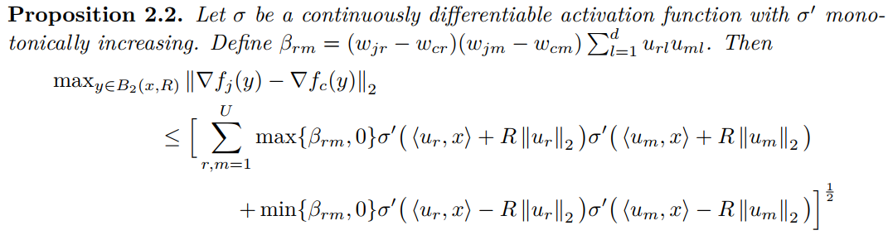
Lipschitz Constant
Neural Network
Evaluation of the Bound for Neural Networks
Proof
?
Hein, Matthias, Maksym Andriushchenko. Formal guarantees on the robustness of a classifier against adversarial manipulation. NIPS 2017.

Slide 19
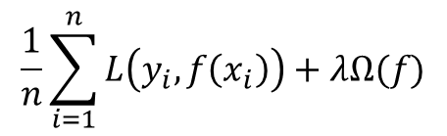

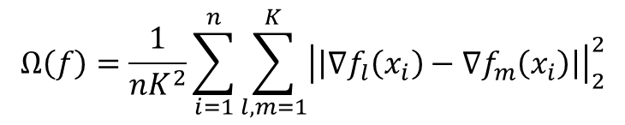
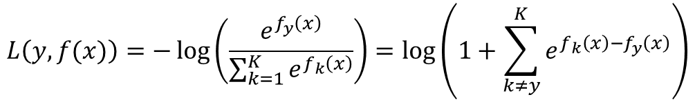
Lipschitz Constant
Regularization
The Cross-Lipschitz Regularization Functional
If $\max_{j≠c}{\max_{y∈B_{p}(x,R)}{{\left|\left|∇f_{c}\left(y\right)−∇f_{j}\left(y\right)\right|\right|}_{q}}}$ is small, $f_{c}\left(x\right)−f_{j}(x)$ is large, then we get good robustness guarantee.
Cross-Entropy Loss $L$: $\{1,…,K\}×ℝ^{K}→ℝ$
Cross-Lipschitz Regularization functional:
The goal is to minimize
?
$$L\left(y,f(x)\right)=−\log\left(\frac{e^{f_{y}\left(x\right)}}{\sum_{k=1}^{K}{e^{f_{k}\left(x\right)}}}\right)=\log\left(1+\sum_{k≠y}^{K}{e^{f_{k}\left(x\right)−f_{y}\left(x\right)}}\right)$$
?
$$Ω\left(f\right)=\frac{1}{nK^{2}}\sum_{i=1}^{n}{\sum_{l,m=1}^{K}{{\left|\left|∇f_{l}\left(x_{i}\right)−∇f_{m}\left(x_{i}\right)\right|\right|}_{2}^{2}}}$$
?
$$\frac{1}{n}\sum_{i=1}^{n}{L\left(y_{i},f\left(x_{i}\right)\right)+λΩ(f)}$$
?
Hein, Matthias, Maksym Andriushchenko. Formal guarantees on the robustness of a classifier against adversarial manipulation. NIPS 2017.

Slide 20
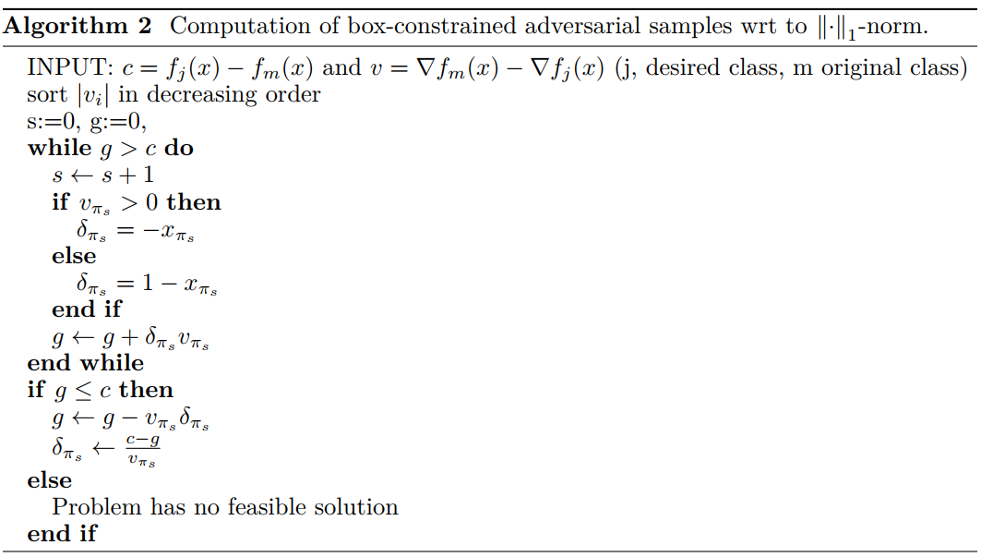
Lipschitz Constant
Algorithm
The Cross-Lipschitz Regularization Functional
Hein, Matthias, Maksym Andriushchenko. Formal guarantees on the robustness of a classifier against adversarial manipulation. NIPS 2017.

Slide 21
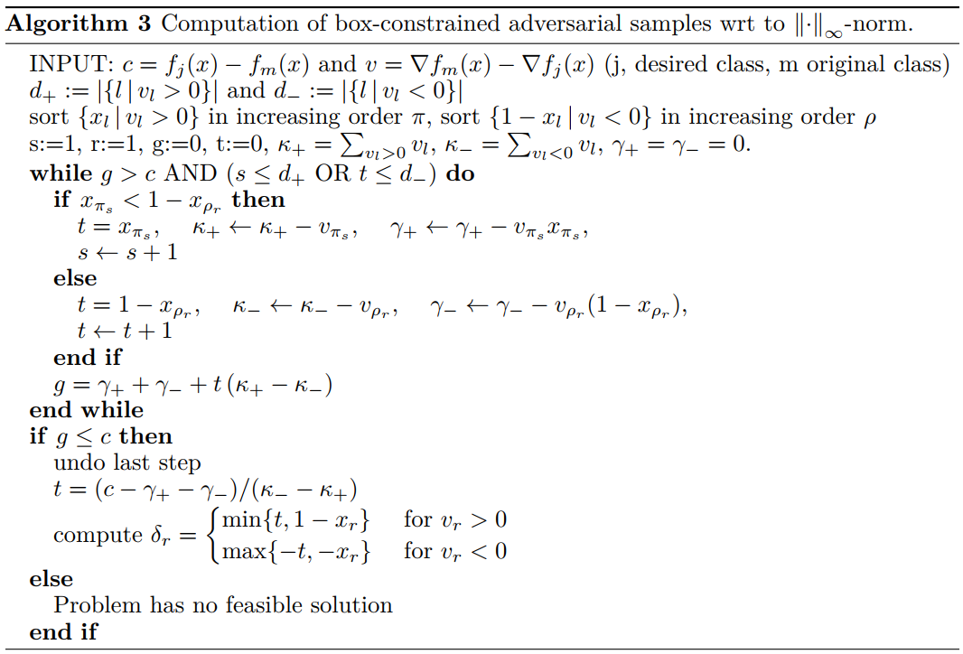
Lipschitz Constant
Algorithm
The Cross-Lipschitz Regularization Functional
Hein, Matthias, Maksym Andriushchenko. Formal guarantees on the robustness of a classifier against adversarial manipulation. NIPS 2017.

Slide 22
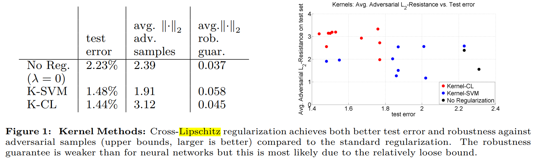
Lipschitz Constant
Experiments
Kernel Methods:
Cross-Lipschitz regularization achieves both better test error and robustness against adversarial samples (upper bounds, larger is better) compared to the standard regularization.
The robustness guarantee is weaker than for neural networks but this is most likely due to the relatively loose bound
Hein, Matthias, Maksym Andriushchenko. Formal guarantees on the robustness of a classifier against adversarial manipulation. NIPS 2017.

Slide 23
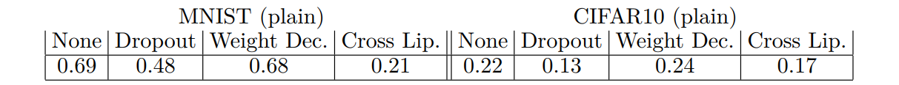
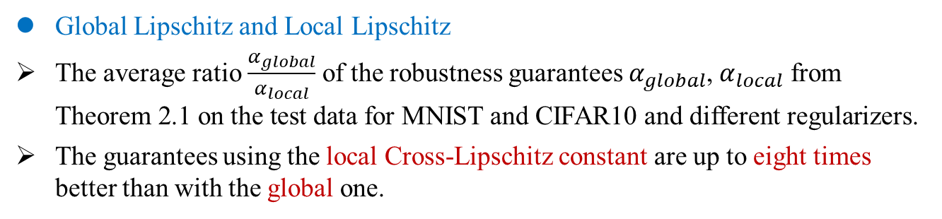
Lipschitz Constant
Experiments
Global Lipschitz and Local Lipschitz
The average ratio $\frac{α_{global}}{α_{local}}$ of the robustness guarantees $α_{global}$, $α_{local}$ from Theorem 2.1 on the test data for MNIST and CIFAR10 and different regularizers.
The guarantees using the local Cross-Lipschitz constant are up to eight times better than with the global one.
?
Hein, Matthias, Maksym Andriushchenko. Formal guarantees on the robustness of a classifier against adversarial manipulation. NIPS 2017.

Slide 24
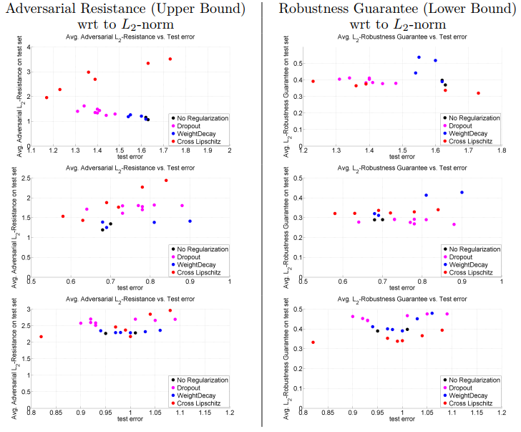
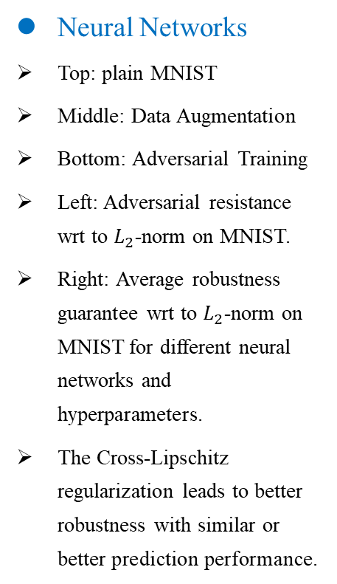
Lipschitz Constant
Experiments
Neural Networks
Top: plain MNIST
Middle: Data Augmentation
Bottom: Adversarial Training
Left: Adversarial resistance wrt to $L_{2}$-norm on MNIST.
Right: Average robustness guarantee wrt to $L_{2}$-norm on MNIST for different neural networks and hyperparameters.
The Cross-Lipschitz regularization leads to better robustness with similar or better prediction performance.
Hein, Matthias, Maksym Andriushchenko. Formal guarantees on the robustness of a classifier against adversarial manipulation. NIPS 2017.

Slide 25
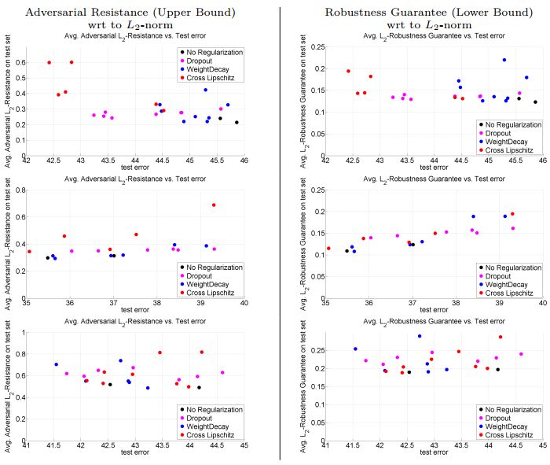
Lipschitz Constant
Experiments
Left: Adversarial resistance wrt to L2-norm on test set of CIFAR10.
Right: Average robustness guarantee on the test set wrt to L2-norm for the test set of CIFAR10 for different neural networks and hyperparameters.
While Cross-Lipschitz regularization yields good test errors, the guarantees are not necessarily stronger.
Top row: CIFAR10 (plain),
Middle: CIFAR10 trained with data augmentation,
Bottom: Adversarial Training.
Hein, Matthias, Maksym Andriushchenko. Formal guarantees on the robustness of a classifier against adversarial manipulation. NIPS 2017.

Slide 26
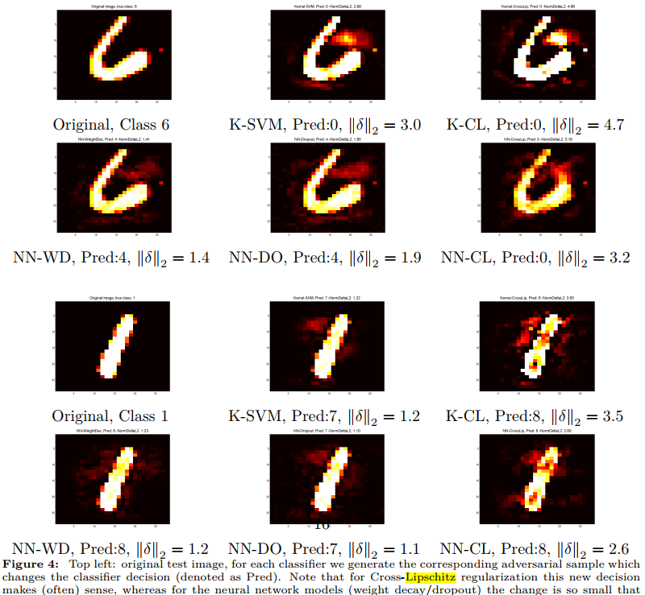
Lipschitz Constant
Experiments
Figure 4
Top left: original test image
Others: adversarial sample
For Cross-Lipschitz regularization, whereas for the neural network models (weight decay/dropout) the change is small.
Hein, Matthias, Maksym Andriushchenko. Formal guarantees on the robustness of a classifier against adversarial manipulation. NIPS 2017.

Slide 27
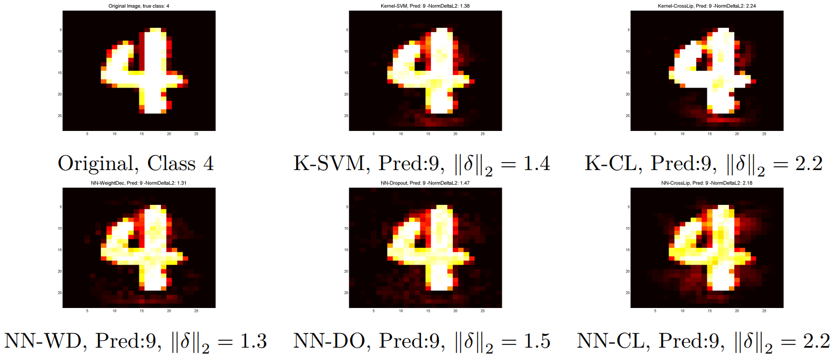
Lipschitz Constant
Experiments
Figure 6
Top left: original test image,
for the kernel methods, whereas for all neural network models the change is so small that the new decision is clearly wrong.
Hein, Matthias, Maksym Andriushchenko. Formal guarantees on the robustness of a classifier against adversarial manipulation. NIPS 2017.

Slide 28
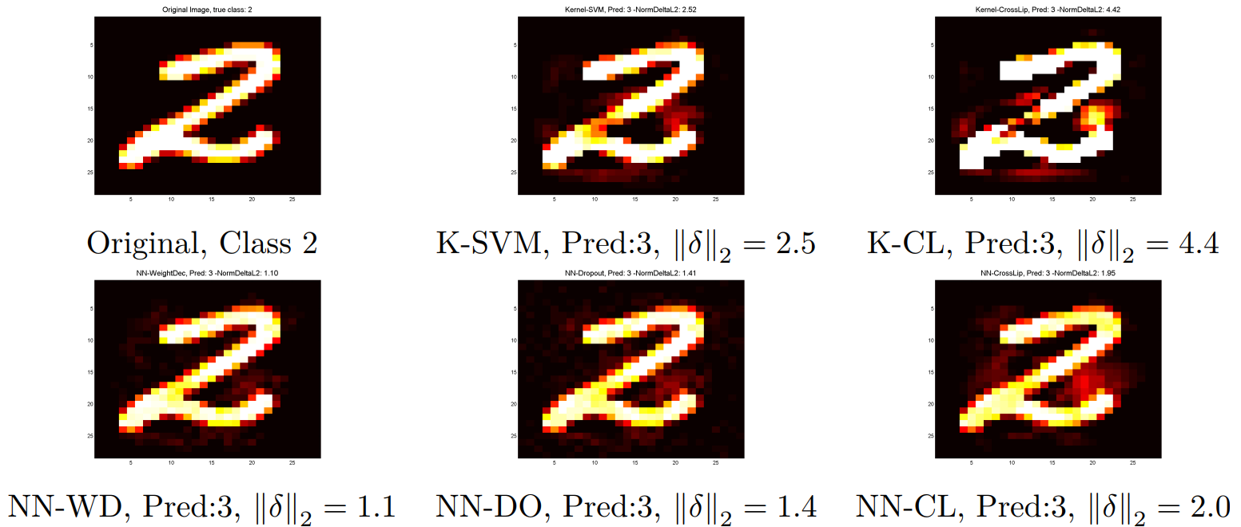
Lipschitz Constant
Experiments
Figure 7
Top left: original test image,
for the kernel methods, whereas for all neural network models the change is so small that the new decision is clearly wrong.
Hein, Matthias, Maksym Andriushchenko. Formal guarantees on the robustness of a classifier against adversarial manipulation. NIPS 2017.

Slide 29
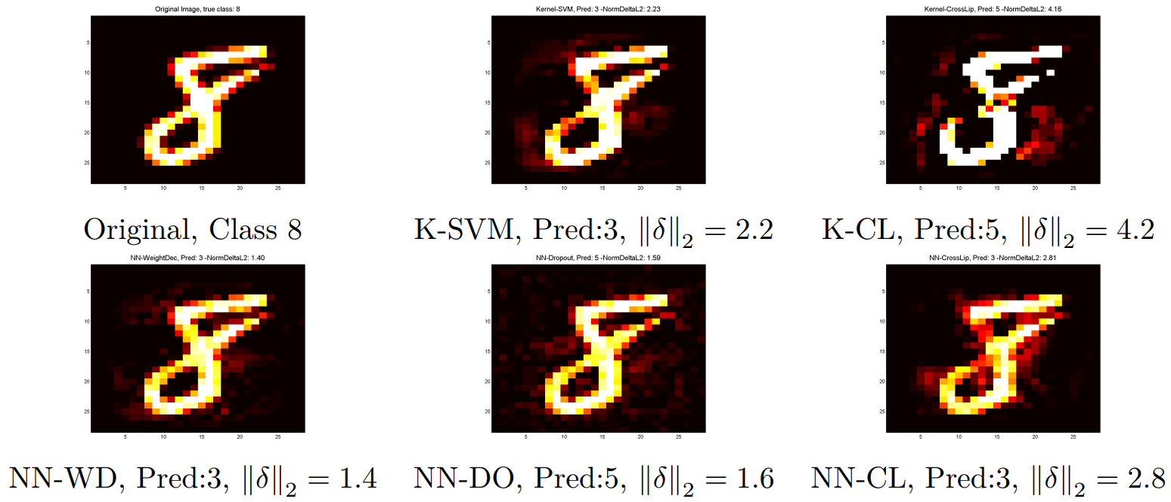
Lipschitz Constant
Experiments
Figure 8
Top left: original test image,
for the kernel methods, whereas for all neural network models the change is so small that the new decision is clearly wrong.
Hein, Matthias, Maksym Andriushchenko. Formal guarantees on the robustness of a classifier against adversarial manipulation. NIPS 2017.

Slide 30
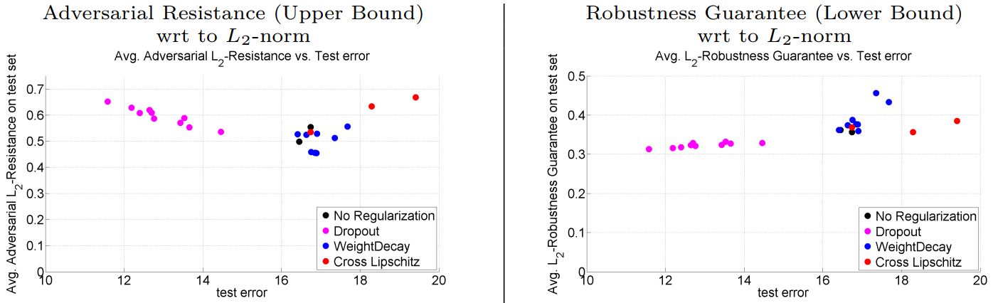
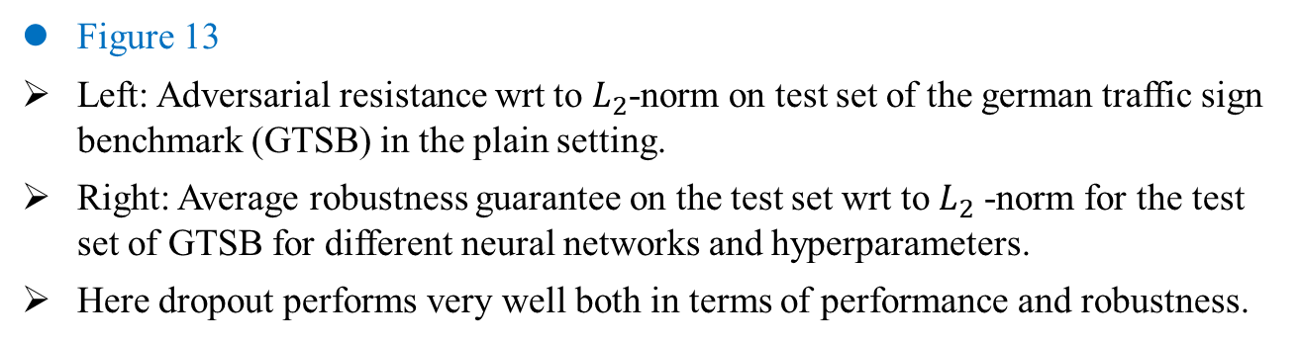
Lipschitz Constant
Experiments
Figure 13
Left: Adversarial resistance wrt to $L_{2}$-norm on test set of the german traffic sign benchmark (GTSB) in the plain setting.
Right: Average robustness guarantee on the test set wrt to $L_{2}$-norm for the test set of GTSB for different neural networks and hyperparameters.
Here dropout performs very well both in terms of performance and robustness.
Hein, Matthias, Maksym Andriushchenko. Formal guarantees on the robustness of a classifier against adversarial manipulation. NIPS 2017.

Slide 31
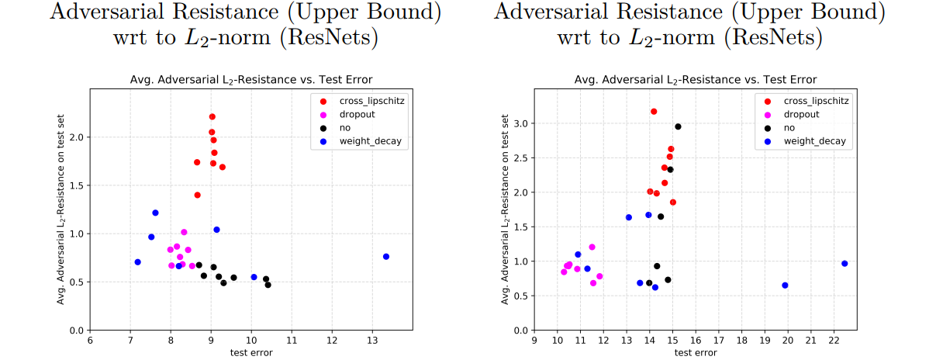
Lipschitz Constant
Experiments
Results on CIFAR10 for a residual network with different regularizers.
As we only have lower bounds for one hidden layer networks, we can only show upper bounds for adversarial resistance.
Left: with data augmentation similar to [25]
Right: plain setting
Hein, Matthias, Maksym Andriushchenko. Formal guarantees on the robustness of a classifier against adversarial manipulation. NIPS 2017.

Slide 32
Lipschitz Constant
Conclusion
Formal guarantees on machine learning systems are becoming increasingly more important as they are used in safety-critical systems.
机器学习模型的形式保证正很重要，尤其是对于重视安全的系统来说。
We think that there should be more research on robustness guarantees (lower bounds), whereas current research is focused on new attacks (upper bounds).
应该对鲁棒性保证（下限）进行更多研究，而目前的研究主要集中在新攻击（上限）上。
We have argued that our instance-specific guarantees using our local Cross-Lipschitz constant is more effective than using a global one and leads to lower bounds which are up to 8 times better.
使用局部 Cross-Lipschitz 常数的特定于实例的保证比使用全局常数更有效，下限好了 8 倍。
A major open problem is to come up with tight lower bounds for deep networks.
该领域的开放问题是：为深度网络提供严格的下限。
Hein, Matthias, Maksym Andriushchenko. Formal guarantees on the robustness of a classifier against adversarial manipulation. NIPS 2017.

